Slide 1
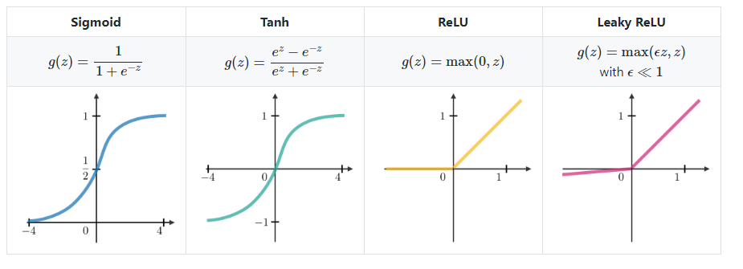
Deep Learning Cheat Sheet
Neurons
Perceptron
Binary inputs and outputs, not very useful in practice for contemporary deep learning models
sigmoid
Transforms outputs to values from 0 through to 1, particularly useful in the output layer
tanh
Similar to sigmoid, but with a floor of -1 instead of 0. Learns a bit more quickly than sigmoid. Useful in sequence specific neuron types
ReLU
Learns very quickly and sparsely activated, since ReLU is zero for all negative inputs
A sparse network is faster than a dense network, as there are fewer things to compute
Intuitively, neurons which can process meaningful aspects are activated, resulting better predictive power and less overfitting/noise
Has the dying ReLU problem, getting stuck on the negative side and always outputting 0 (slope of ReLU in the negative range is always 0)
Leaky ReLU
Learns even faster and addresses the “dying ReLU” problem
Not always superior to plain ReLU in terms of consistency, should be considered as an alternative

Slide 2
Deep Learning Cheat Sheet
Const functions
Quadratic
Cross-entropy

Slide 3
Deep Learning Cheat Sheet
Gradient descent
Learning rate
Mini-batch size
Second-order derivative (Adam)

